Slide 1
Deephaven as an Application Framework
How the runtime really behaves across components, from startup to shutdown, and what that means for where our code should live
Taylor · October 2026 · every claim tested on Deephaven Community 42.6
Notes:
Purpose: share what we learned building and probing Deephaven applications, and propose where application code should live on the plant. Everything marked verified was observed in a test in our repo; Enterprise points come from Deephaven's documentation.

Slide 2




The short answer
A declarative engine
One namespace, published
Scripts declare a graph of tables once; the update graph keeps it current, one consistent ~1 s cycle at a time.
Console commands, run_script and app-mode scripts share one global scope; every exportable name is a field clients can open.
The clock can be ours
Place work by its shape
An event-driven update graph advances only when our code calls requestRefresh(): one call, one checkpoint.
Table work in PQs; stateful applications beside them as a subprocess, a thread-hosted service or a client.
Notes:
Four messages. One: Deephaven is a declarative dataflow engine, not an event loop. Two: a worker has one Python namespace and publishes what is named in it. Three: the biggest discovery is that the clock does not have to be Deephaven's. Four: place work by its shape.

Slide 3
How we know: every claim traces to a test
39
9
2
3
verified facts in the ledger, each with its test or source
earlier claims corrected by later tests
UI routes built on one server: deephaven.ui and React
ways to host Deephaven next to our framework, all run
The evidence
A ladder of experiments (lifecycle, declarative DAG, listener hooks, multi-feed checkpoints), probes of scopes, fields and tickets, runtime probes (executors, an event-driven clock, Deephaven on a thread, Deephaven as a subprocess), and an introspection module run against a live worker.
Community 42.6 in Docker and as the pip server natively on Windows. Enterprise behaviour comes from Deephaven's documentation and is marked as such.
Notes:
We built a mock market-making book twice, once with deephaven.ui and once in React, then ran a ladder of experiments and probes. The ledger file lists each verified fact with the test behind it. Nine claims we made early on turned out to be wrong and are corrected in the appendix.

Slide 4
1 The runtime in space
What lives inside one worker, how it is named, and how clients and other workers reach it
Notes:
First the static picture: the parts of a worker and the boundaries between them.

Slide 5
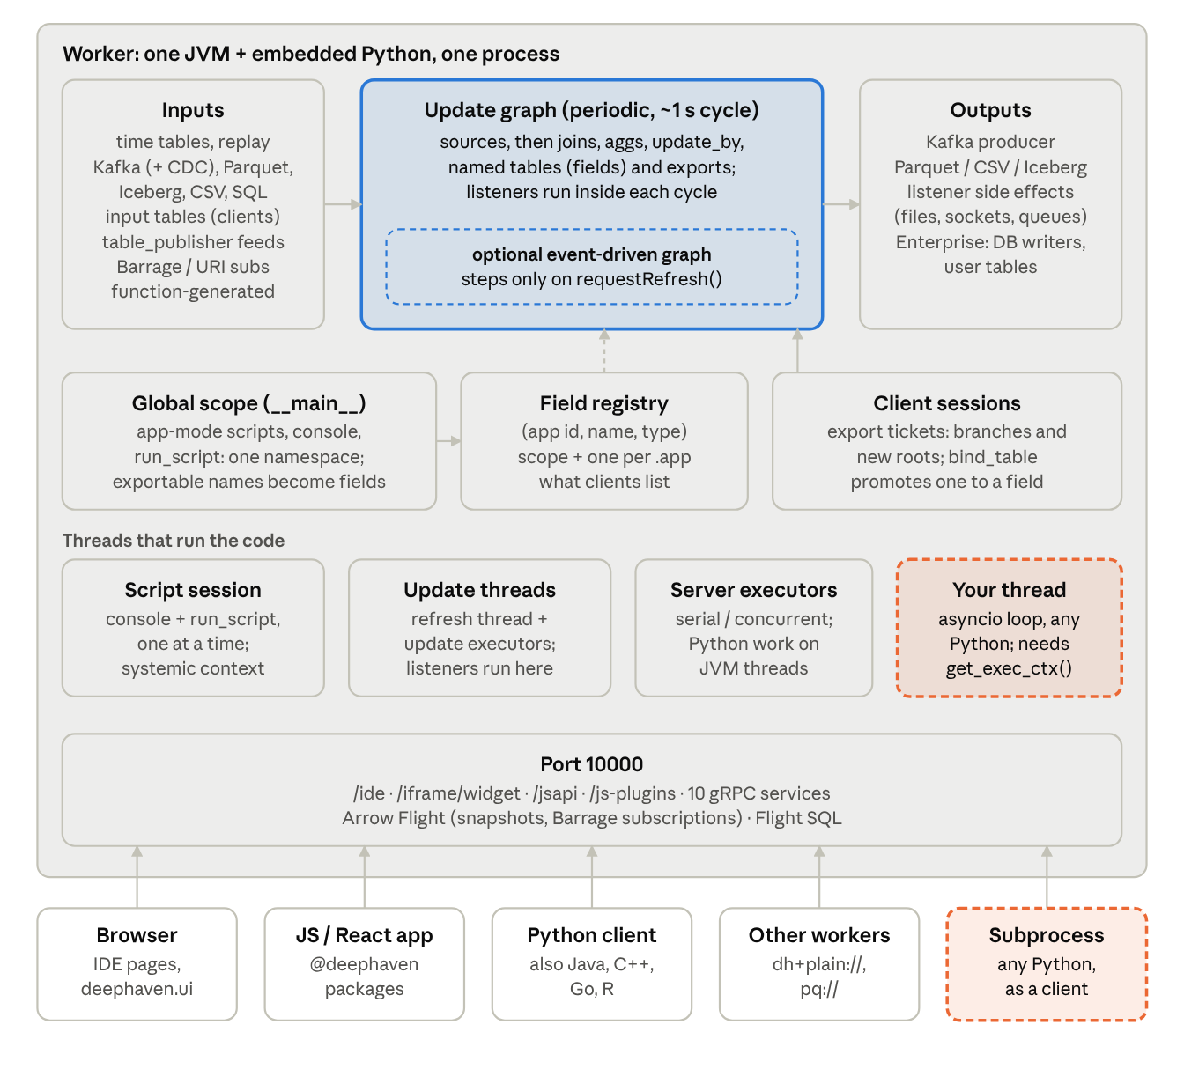



Everything happens inside one worker process
Inputs feed one graph
Time tables, Kafka, files, input tables, Python feeds and Barrage subscriptions all become source nodes.
Our threads are guests
Engine threads run cycles and listeners; any thread we start needs an execution context handed to it.
One port for everyone
The IDE, deephaven.ui, React apps, Python clients and other workers all come through port 10000.
Notes:
Read top to bottom: inputs feed the update graph and outputs hang off it. By default there is one periodic graph; code can add an event-driven one. The global scope and field registry are the naming layer. Below them are the threads that actually run code, and at the bottom one port that every client uses. Dashed orange is code we run outside the engine's control.

Slide 6
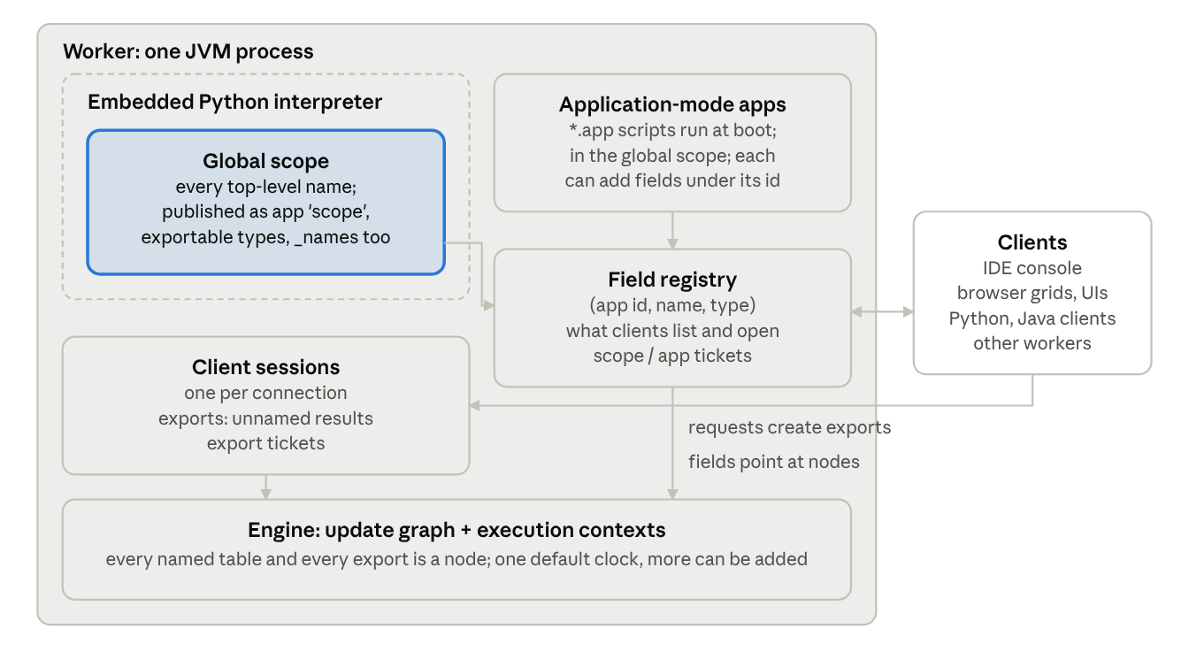
A worker publishes fields; clients reach them through tickets
Ticket | Bytes | Lives until
Scope | s/<name> | the name is unbound
Application | a/<app>/f/<field> | the app drops it
Export | e + 4-byte number | released or session ends
Shared | h + 16 random bytes | the publisher's session ends
Tested
Underscore names are published too
Two apps may use the same field name
bind_table outlives the binding session
A shared ticket dies with its publisher
Notes:
Fields are the worker's interface: named, typed objects from every application, including the scope application. Clients never see Python variables, only tickets. Export tickets are the unnamed objects a session creates, such as a sorted grid. Shared tickets die with the session that published them; bind_table makes a durable name instead.

Slide 7
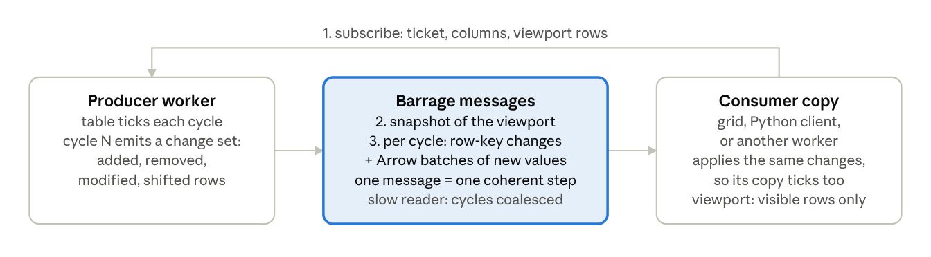
Live tables travel as change sets, not copies
Viewports
One message, one step
Coalescing
Subscribe to rows 0–49 of two columns; only visible, changed values travel.
Each message is a coherent update-graph step on the producer, never half a cycle.
A slow subscriber gets several cycles merged into one message, not a backlog.
Notes:
Barrage is Arrow Flight extended for ticking data: a snapshot, then each cycle's added, removed, modified and shifted rows. The consumer replays those onto its own copy, so it ticks too. Every grid in both of our UIs is a Barrage viewport subscription.

Slide 8
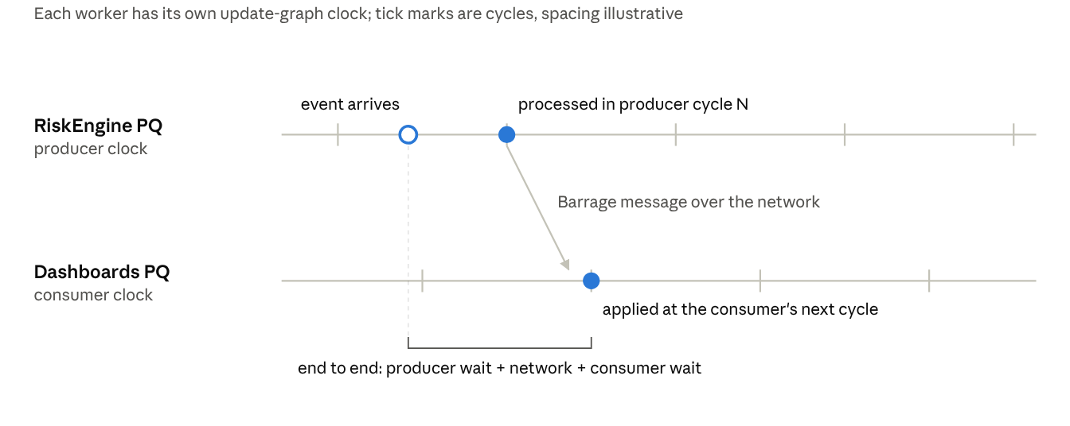
Across workers, each side keeps its own clock
Cross-worker latency
producer wait + network + consumer wait
Enterprise (docs)
pq://RiskEngine/scope/positions
Community (tested)
dh+plain://host:port/app/<id>/field/<name>
Resolving either adds a Barrage source node to the consumer's graph, even when it points at the same server.
Notes:
A table shared between PQs is a Barrage subscription, so it ticks on the consumer's clock. Inside one worker, a join is consistent at every step; across workers, each side is consistent with itself. We saw the same thing locally: resolving a dh+plain URI created a Barrage source node, even pointing at the same server.

Slide 9
2 The runtime in time
Startup, steady-state cycles and shutdown, across every thread and process
Notes:
Now the same application over time: what runs once, what runs every cycle, and how it ends.

Slide 10
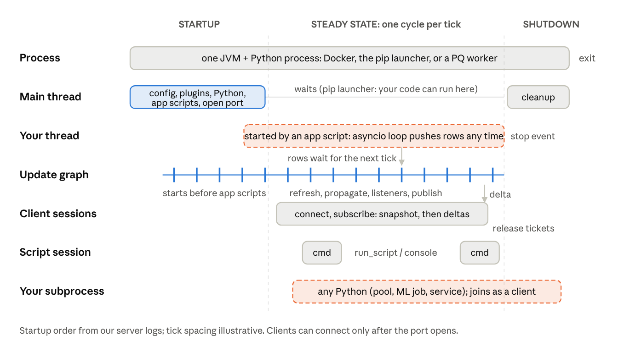
Startup builds the graph once; then each cycle drives it
Once
config, plugins, Python, app scripts, then the port opens
Every tick
refresh sources, propagate, run listeners, publish deltas
At the end
stop events, stop listeners, flush sinks, close sessions
Notes:
Read a column top to bottom for one moment. The update graph starts cycling before the app scripts finish. Clients can connect only after the port opens. Rows from our thread wait for the next tick, flow through the graph, and reach clients as one delta. Shutdown is only as orderly as our own cleanup.

Slide 11
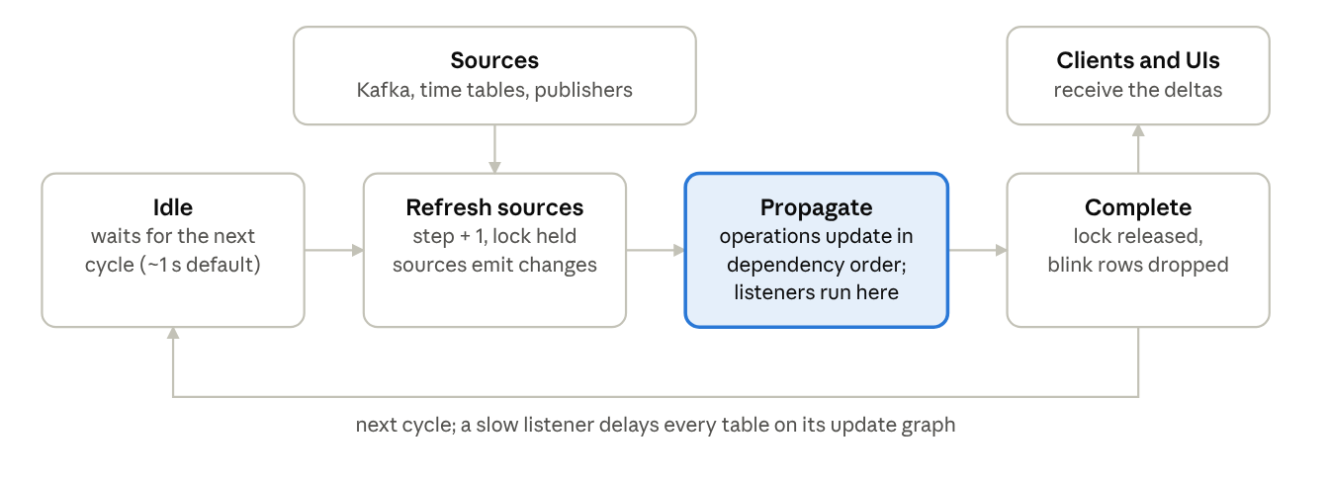
Each cycle is one consistent checkpoint
~1 s
≤ 1,000 ms
1 callback
default cycle; ticks 0.5 s apart arrived in pairs
rows pushed from Python waited for the next cycle
per cycle, with ~4 quotes, 4–5 orders, 1–2 signals
Notes:
Every cycle refreshes all sources, propagates changes in dependency order, and publishes one step. Our listeners run inside the propagate step, so a slow one delays every table on that graph. Measured: ticks half a second apart were processed in pairs. Rows pushed from Python waited up to a second. One merged listener saw all three feeds at once.

Slide 12
The clock can be ours: an event-driven update graph
Push three rows
requestRefresh()
One step
Again
A: 100, 200, 300
our checkpoint
1 callback: A = 600
A 5, B 7 + refresh
1.5 s idle: still step 2, 0 callbacks
one call from our code
step 3: all three pushes together
step 4: 1 more callback
ug = EventDrivenUpdateGraph.newBuilder("synchronizer_clock").build()
ctx = ExecutionContext(j_exec_ctx=
get_exec_ctx().j_exec_ctx.withUpdateGraph(ug))
with ctx:
feed, pub = table_publisher("sync_feed", cols,
update_graph=UpdateGraph(j_update_graph=ug))
sums = feed.agg_by([agg.sum_("Qty")], by="Sym")
listen(sums, on_checkpoint)
pub.add(rows) # x3: nothing moves on its own
ug.requestRefresh() # our checkpoint
What it buys a framework
Checkpoints on our cadence, not a fixed second
Engine-consistent joins and aggregations at each one
Listeners that fire exactly once per checkpoint
Tested on Community 42.6; whether PQs allow it is a vendor question
Notes:
This is the finding that matters most for our framework. We built an event-driven update graph from Python, put a feed and a listener on it, and pushed three rows. For a second and a half nothing happened. One requestRefresh delivered all three as a single step: A equals 600, the sum of 100, 200 and 300. Our synchronizer decides when a checkpoint happens; Deephaven makes it consistent.

Slide 13

Threads: only some carry a real execution context
Thread | Runs | Execution context
Thread that starts the server | startup, application-mode scripts | real (systemic)
Script session (serial) | console and run_script commands | real (systemic)
Update threads | cycles, propagation, our listeners | engine
Server executors | submit_task work on JVM threads | server
Our threads | feeds, timers, an asyncio loop | static-only until we pass one in
Our subprocesses | anything | none: client access only
Measured
get_exec_ctx() on the host's main thread → static-only → UpdateGraphConflictException
Fix
Capture the context where it is real (inside run_script, or on the server's thread), pass it in, and enter it with with ctx:
Notes:
Every table operation runs under an execution context: query scope, compiler, update graph, auth. Contexts are per thread. The script session and the thread that started the server have the real one. On our own threads, get_exec_ctx returns a static-only context, and building a ticking table fails. We measured exactly that on the host's main thread.

Slide 14
Python listeners are the costliest nodes in the graph
~195 ms
per interval for each Python listener
3–36 ms
for most Java operations; 80 ms for rolling update_by
Python in a listener holds the GIL on the update thread, so its cost lands on every table in that cycle.
Notes:
From the engine's own performance log for experiments 2 to 4. The two Python listeners cost about 195 milliseconds per interval each, against 80 for the costliest Java operation and 3 to 36 for the rest. Table logic belongs in the query language; Python belongs at the edges.

Slide 15



Lifecycle bugs fail silently in a long-lived worker
A listener that throws stops for good
One traceback, then silence; feeds keep flowing and the worker looks healthy. Wrap every hook and record failures.
Re-running setup stacks listeners
Rebinding the handle does not stop the old one; outputs were written twice. Stop the previous handle first.
Leaked tasks outlive their code
Old asyncio loops read the next run's stop flag from a global and ran forever. Pass lifecycle objects in explicitly.
Shutdown is a hard stop
No Python shutdown hook; on Windows terminate() killed the server with exit 1. Flush and clean up on request, before stopping.
Notes:
Each of these happened to us. In a worker that lives all day and is shared, they are worse than in a process we own, because nothing reports them and only a restart clears them.

Slide 16
3 Hosting and placement
Where our framework and Deephaven each run, and what every choice costs
Notes:
With the runtime understood, the practical question: how should our framework and Deephaven fit together?

Slide 17
Three ways to combine our framework with Deephaven
 | Framework inside a worker | Deephaven on a thread of ours | Deephaven as a subprocess or service
Owns the main loop | Deephaven | Us | Us
Checkpoints | ~1 s cycle or an event-driven graph | Event-driven graph our synchronizer steps | Snapshots and subscriptions
Data path | In-process | In-process, no network hop | Network: Barrage
Python interpreter | Shared with the engine | Shared: listener lag doubled under load | Separate
Failure domain | Shared | Shared | Separate
Console exposure | Our code lives in the worker scope | Our __main__ is the console scope | Only what we publish
Restart | A new worker | Only with our process | Restart the subprocess
On the plant | A PQ | Not applicable | A client of PQs
Notes:
We tested all three. Putting the framework inside a worker gives up the main loop and shares everything. Hosting Deephaven on a thread of our own process keeps our loop and lets our synchronizer step an event-driven graph directly, but shares one interpreter and our globals. A subprocess gives full isolation for one network hop.

Slide 18
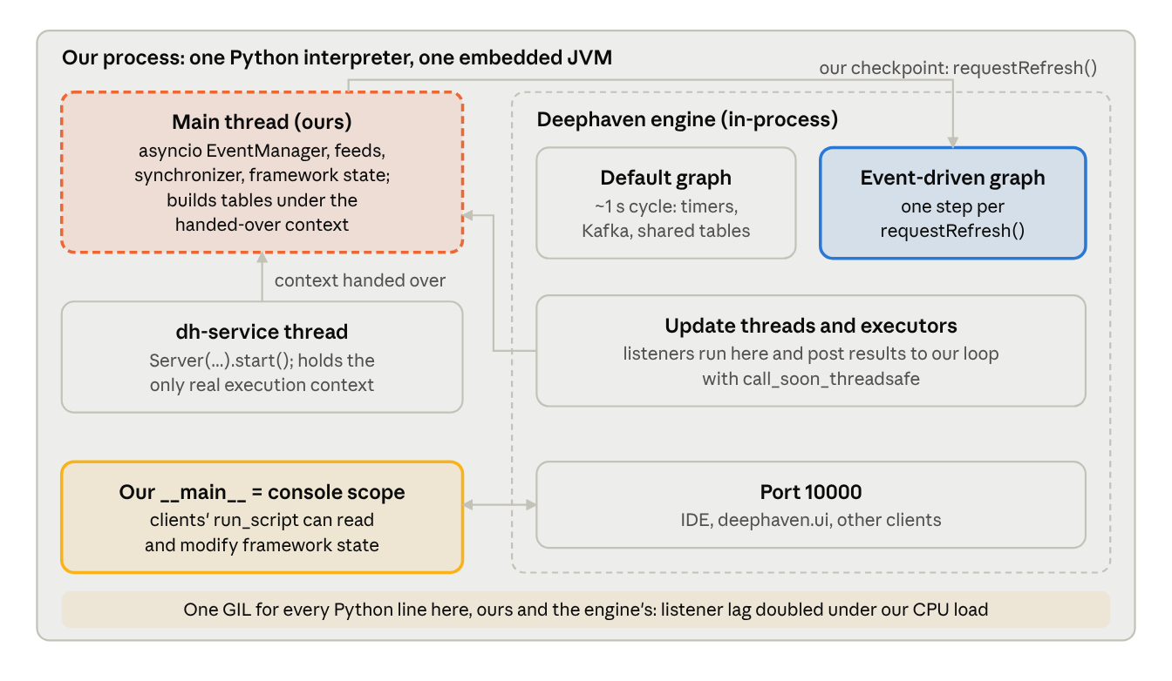
Embedded: Deephaven on our thread, stepped by our clock
9.4 s
to start on a background thread; clients connected normally
36.6 → 74.8 ms
median listener lag, idle vs. host burning CPU in Python
1
server per process: a second start() is refused
__main__
is the console scope: a client modified our state
Notes:
Deephaven does not insist on the main thread. The pip server started on a background thread in 9.4 seconds while our asyncio loop kept running, at about half speed. Tables and listeners worked in-process with the context handed over from the server's thread. The costs: a shared interpreter, our module globals open to console clients, and one server per process.

Slide 19
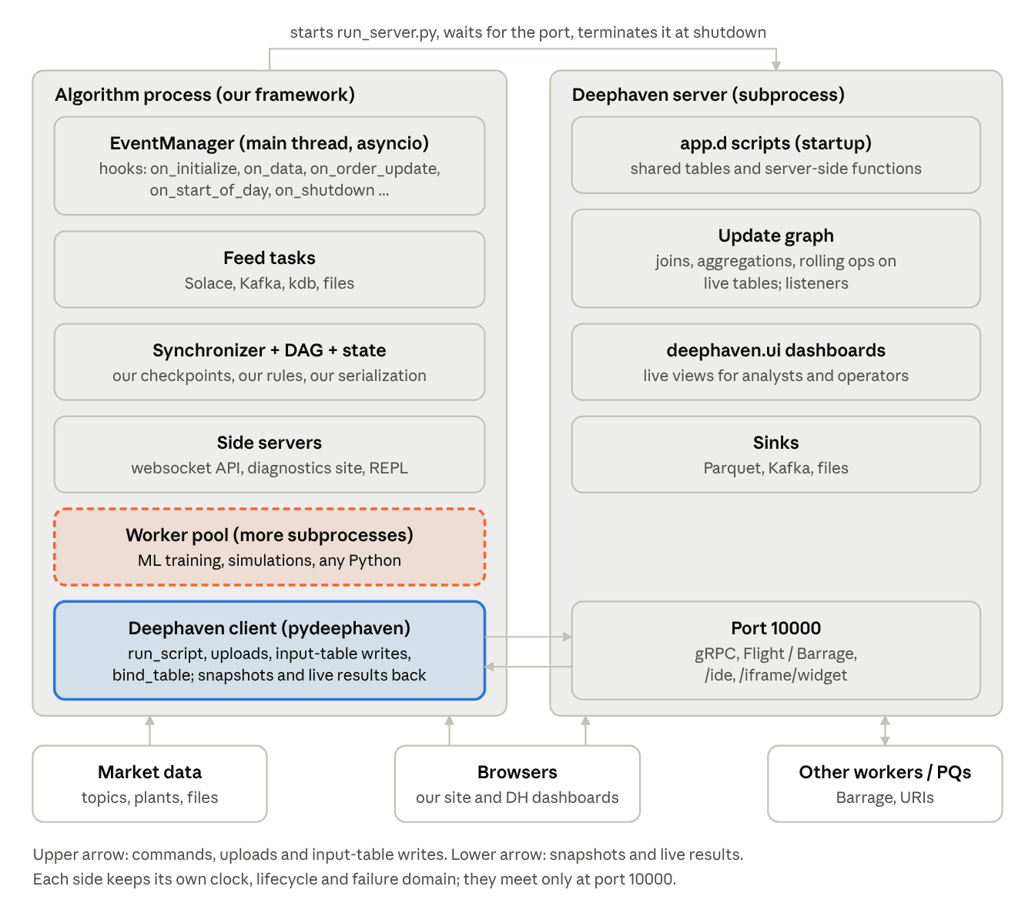
As a subprocess: isolation for one network hop
10.9 s
from launch to a connected client session
6 → 21 → 26
per-symbol counts at our 1.5 s checkpoints: whole engine cycles
exit 1
Windows terminate() is a hard kill: stop gracefully by request
1 port
is the whole boundary between the two runtimes
Notes:
Our host process started a second server as a subprocess, deployed logic with run_script, and read results at three checkpoints on its own clock while a worker pool ran unrelated computation. Counts arrive in whole engine cycles, so they step unevenly against our clock. On Windows terminate is a hard kill, so shut down by request.

Slide 20
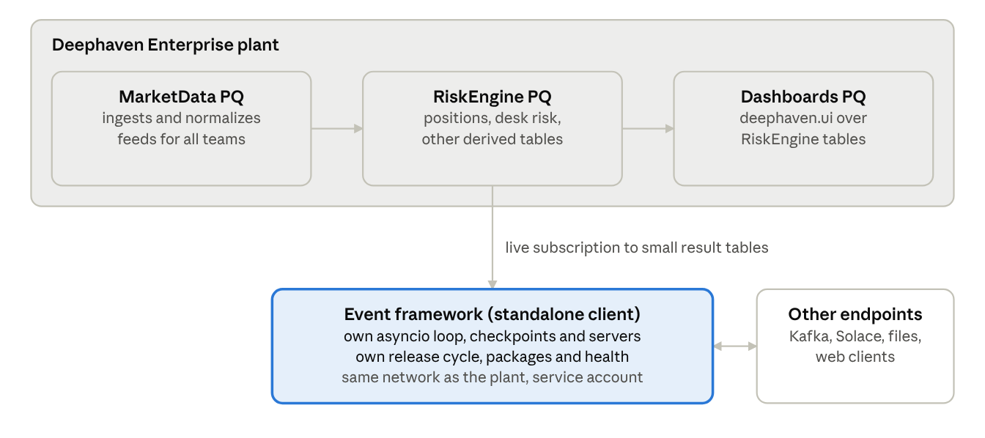
On the plant: table work in PQs, stateful apps beside them
The one-question test
Mostly table operations?
Run it as a PQ.
Mostly other work with some table data?
Run it beside the plant as a client, a subprocess service or a thread-hosted engine.
Notes:
The recommended layout. Shared, table-shaped work runs in PQs that subscribe to each other. The stateful framework keeps its own runtime and pulls only the results it acts on. The test: is the app mostly table operations, or mostly other work with some table data?

Slide 21


We can inventory a running app without its source
What the report shows
What it cannot
Every exposed field and its type, across all apps
What a listener does inside its Python code
Scope objects by kind, underscore names included
Edges for nodes created before the ancestors log opened
Every update graph, including event-driven ones
Ports and memory on Windows (read from /proc)
Nodes with per-interval cost and dependencies
One ask of every PQ author
Open perfmon.update_performance_ancestors_log() at the top of the startup script, so the full graph can be drawn later.
Listeners vs. the handles that can stop them
Unnamed nodes: client exports or leaks
Python threads, libraries, executors
Notes:
Our introspection module runs inside a worker, through any client with console access. It reports the field registry, scope objects by kind, the update graphs with per-node cost, listeners against the handles that can stop them, nodes no name leads to (client exports or leaks), and Python threads. It cannot see what a listener does inside its Python code.

Slide 22
Decisions and next steps
1
2
3
4
Adopt the placement rule
Pave the road for client apps
Pilot one real algorithm
Ask the vendor in writing
Table work in PQs; stateful apps beside them. Exceptions argued case by case.
One approved container template, CI pipeline and service-account connection.
Event-driven clock; thread-hosted vs. subprocess; measure latency, isolation, risk.
Event-driven graphs in PQs, isolation, health checks, shutdown hooks, console attach.
Repo: deephaven-compare · ledger: VERIFIED_FACTS.md · companion docs: Findings and Guidance, Concepts, Anatomy
Notes:
Four concrete steps. The pilot is the most important: one real algorithm, run with an event-driven clock, hosted both on a thread and as a subprocess, measured on latency, isolation and operational risk.

Slide 23
Appendix: nine earlier claims our tests corrected
Earlier claim | What the tests showed
App-mode scripts need `global` to reach the console scope | Not on Community 42.6 Python: they run in the global scope
An underscore keeps a name private | Underscore names are published as fields
Export tickets look like e/<n> | e followed by a 4-byte binary number
A shared ticket can outlive its publisher | It dies with the publishing session
One clock per worker | One by default; more can be added, including event-driven
No built-in Solace or kdb connector | Enterprise has Solace streaming import (docs); no kdb connector known
Unknown whether PQ scripts can come from Git | Enterprise supports Git-sourced PQ scripts (docs)
Native Windows is unsupported | The pip server runs with three workarounds
get_exec_ctx() works on any thread | Only on a thread that already holds a real context
Notes:
For credibility: these are claims we made before testing, and what the tests showed.

